Slide 1
Suricata安裝
410570190 施宇倫

Slide 2
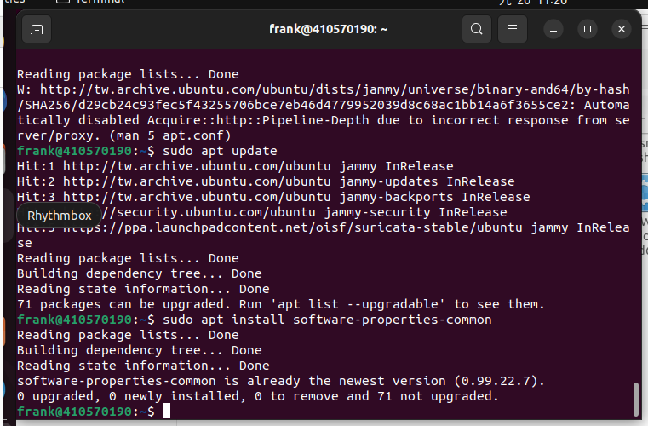
sudo apt install software- properties-common

Slide 3
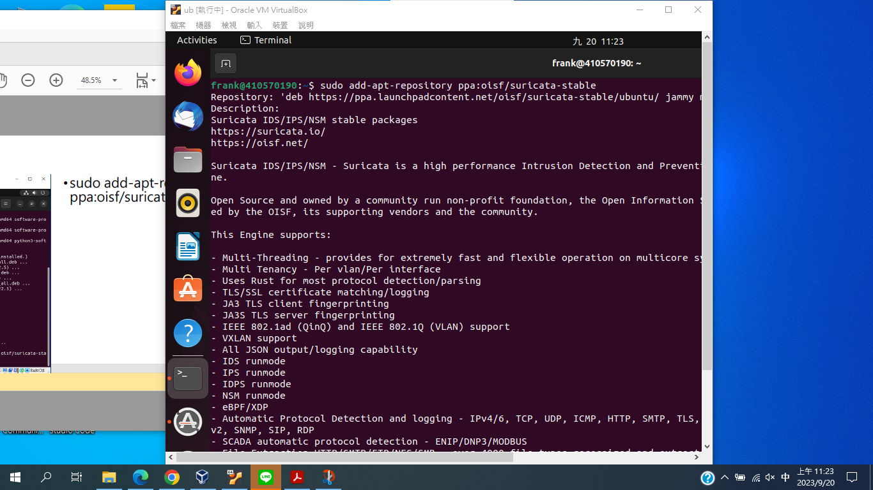
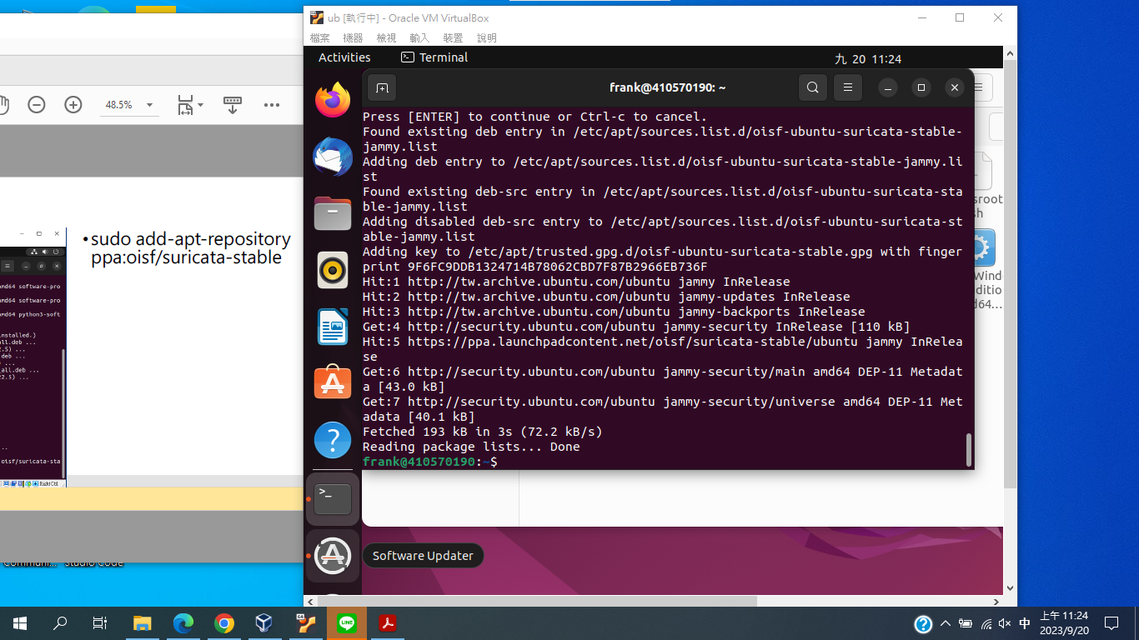
sudo add-apt-repository ppa:oisf/suricata-stable

Slide 4
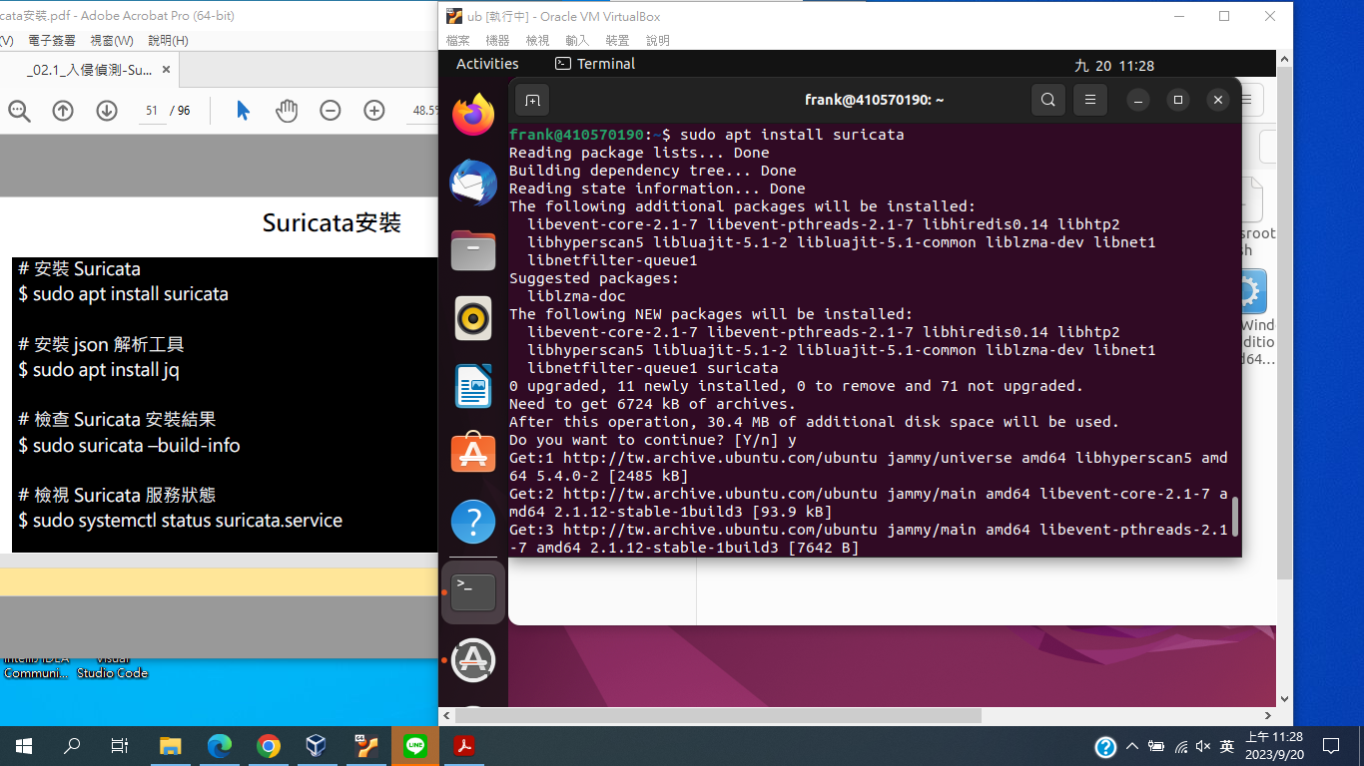
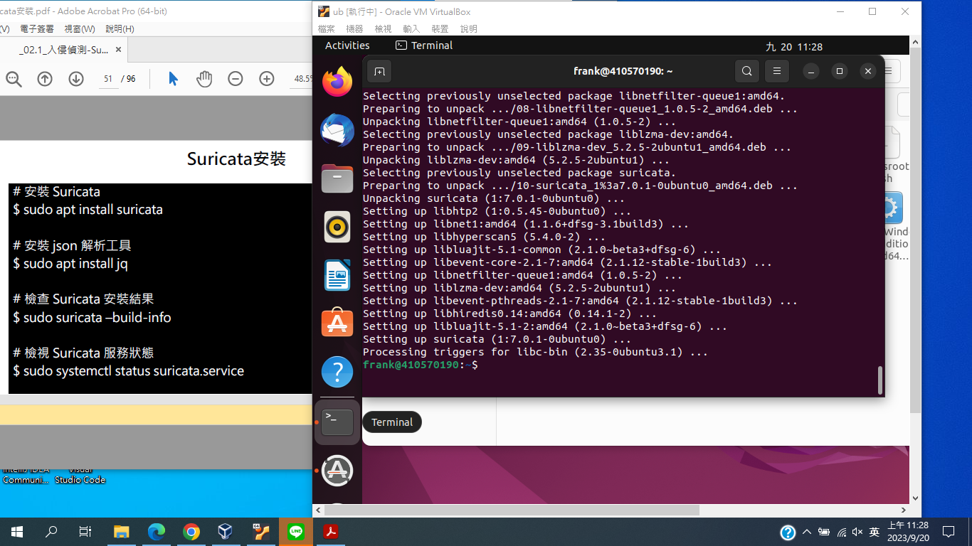
# 安裝 Suricata $ sudo apt install suricata

Slide 5
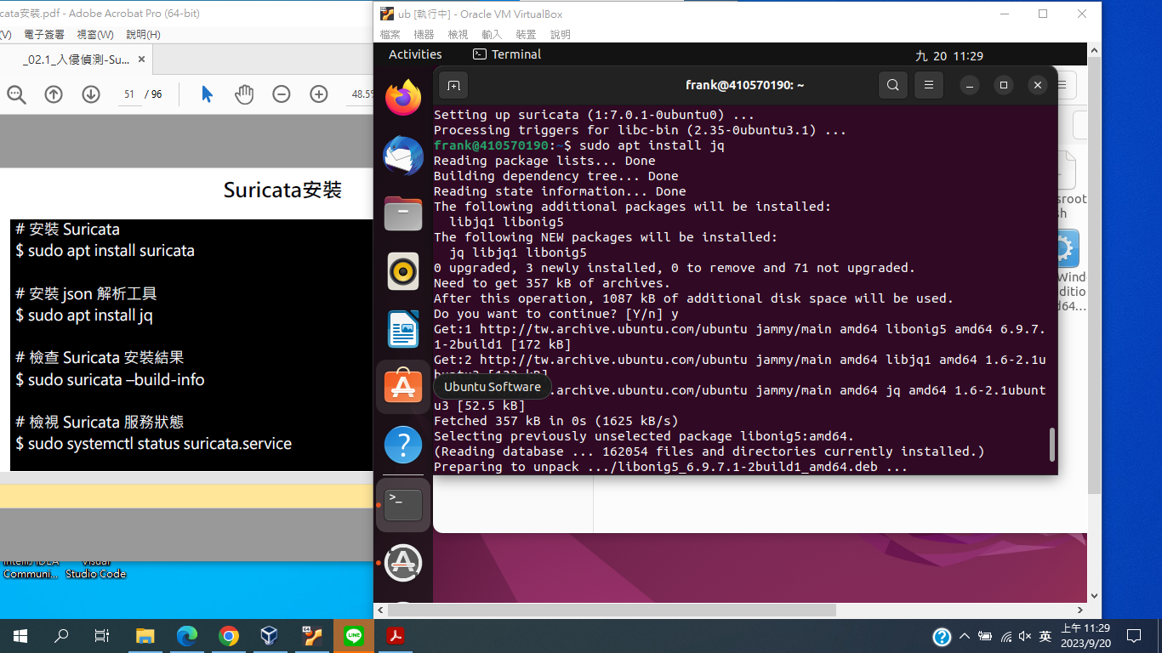
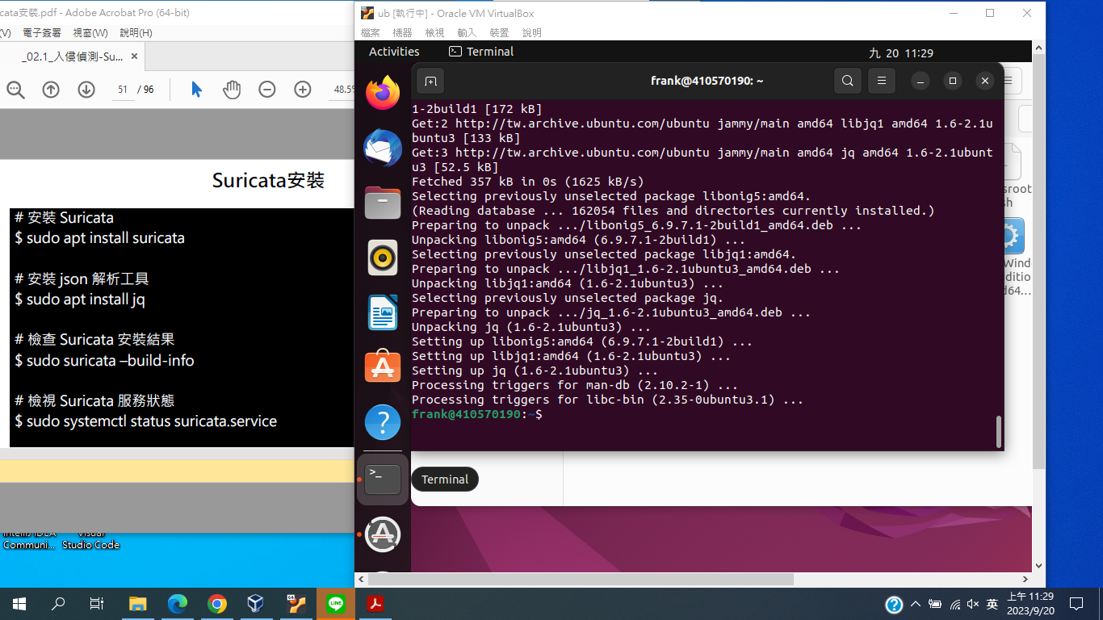
# 安裝 json 解析工具 $ sudo apt install jq

Slide 6
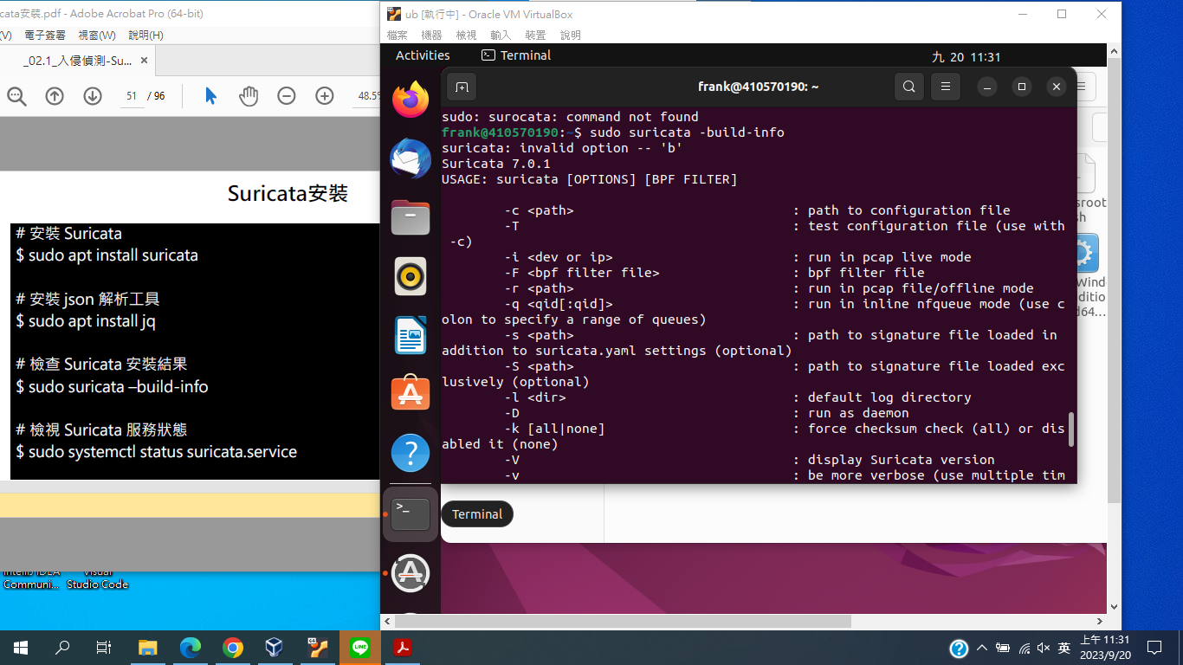
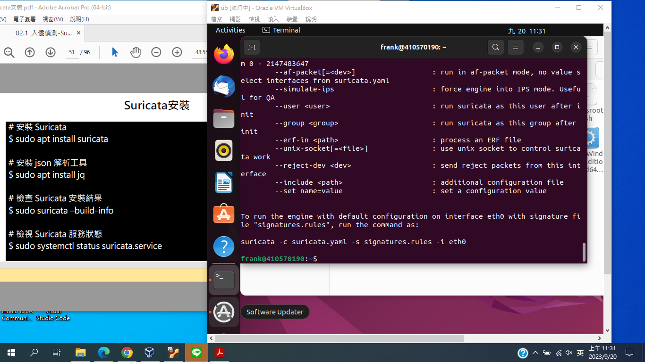
# 檢查 Suricata 安裝結果 $ sudo suricata –build-info

Slide 7
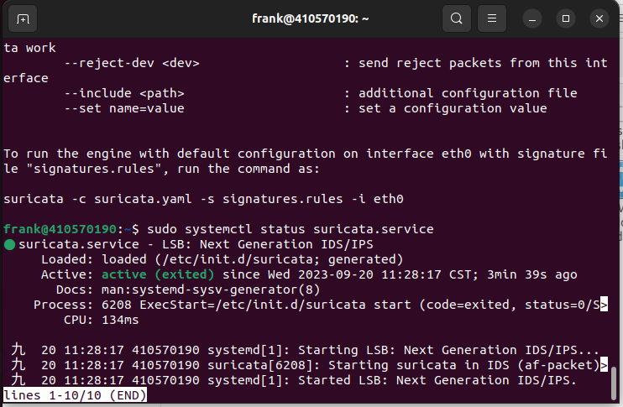
# 檢視 Suricata 服務狀態 $ sudo systemctl status suricata.service
按ctrl+c退出

Slide 8
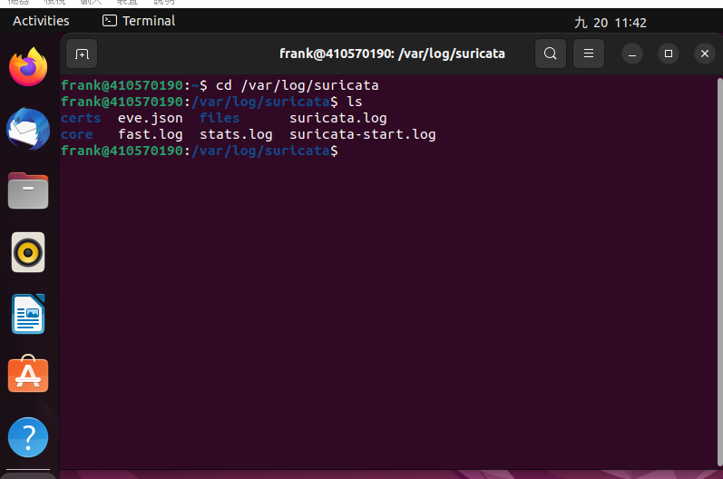
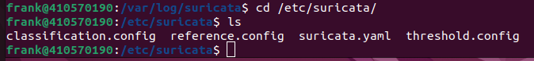
$ cd /var/log/suricata/ $ ls

Slide 9
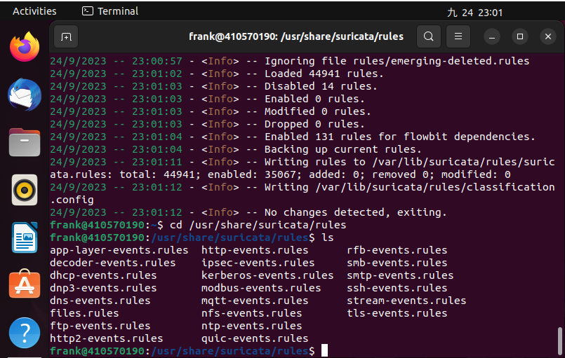
$ cd /etc/suricata/rules $ ls

Slide 10
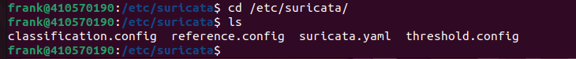
$ cd /etc/suricata/ $ ls

Slide 11
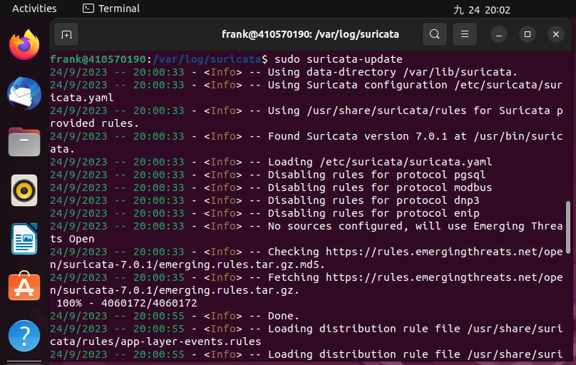
$ sudo suricata-update

Slide 12
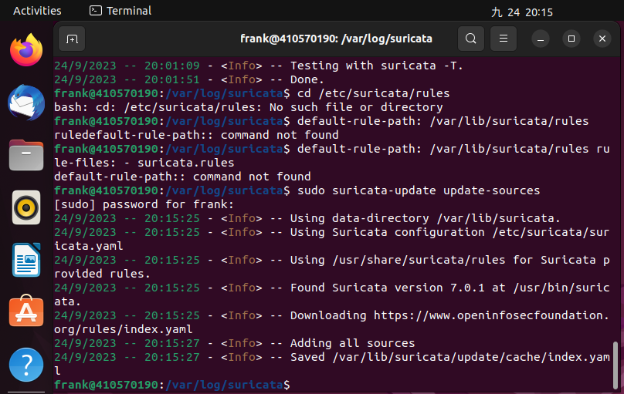
$ sudo suricata-update update-sources

Slide 13
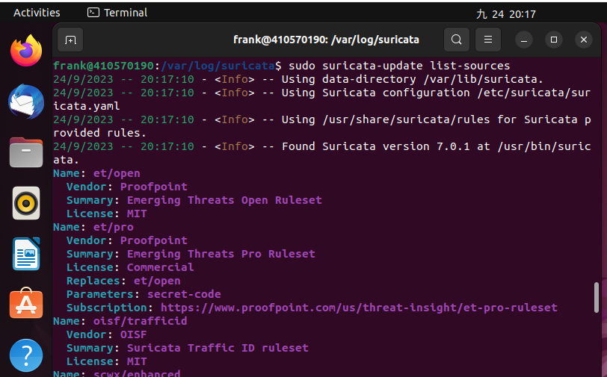
$ sudo suricata-update list-sources

Slide 14
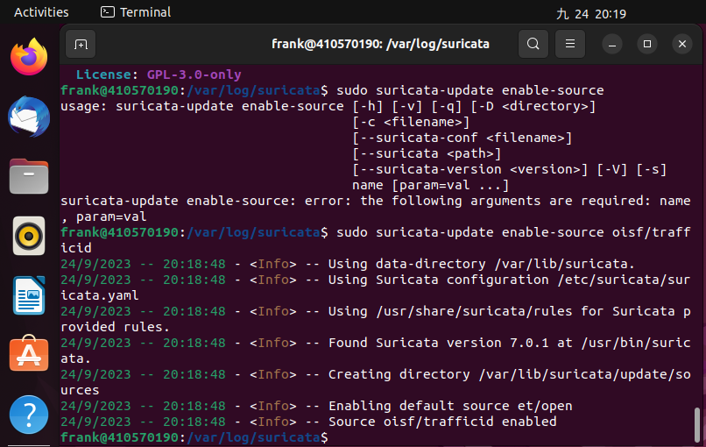
$ sudo suricata-update enable-source oisf/trafficid

Slide 15
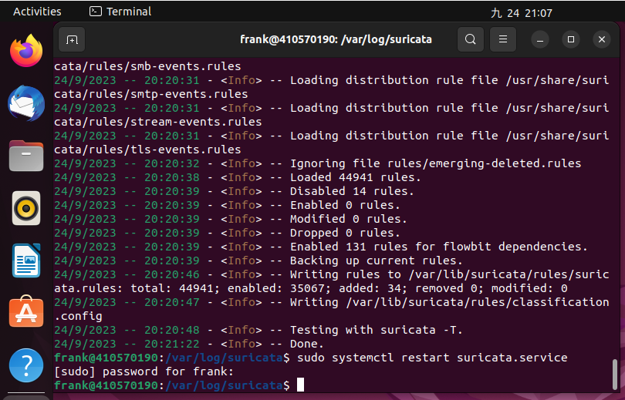
$ sudo systemctl restart suricata.service

Slide 16
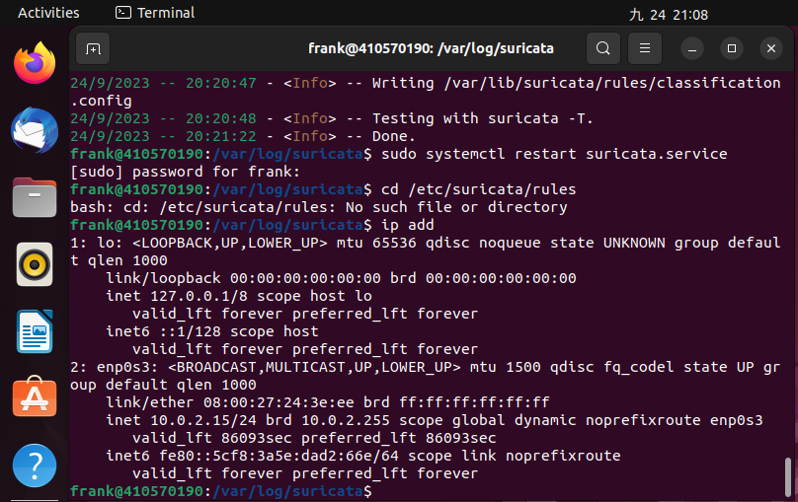
$ ip addr

Slide 17
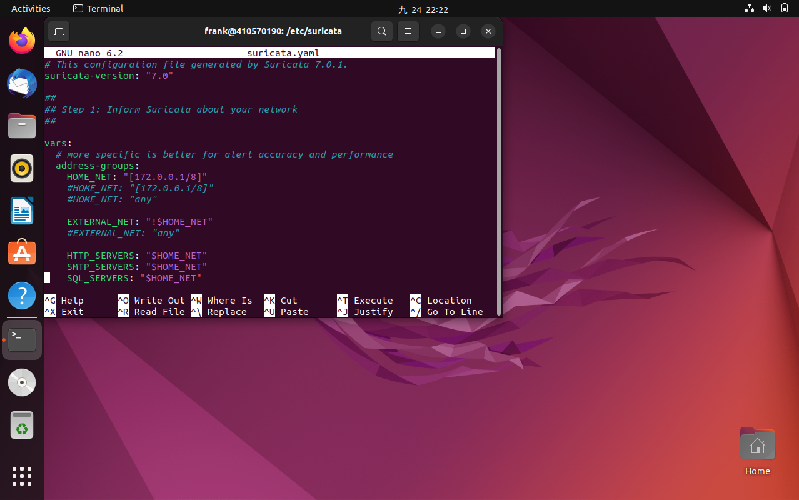
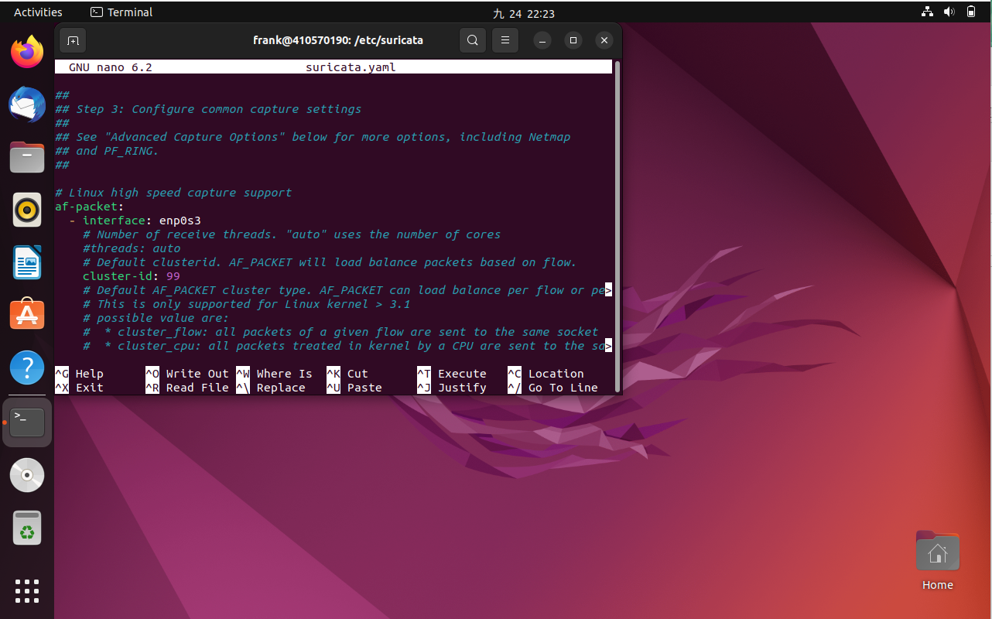
$ sudo nano suricata.yaml 換id、ip

Slide 18
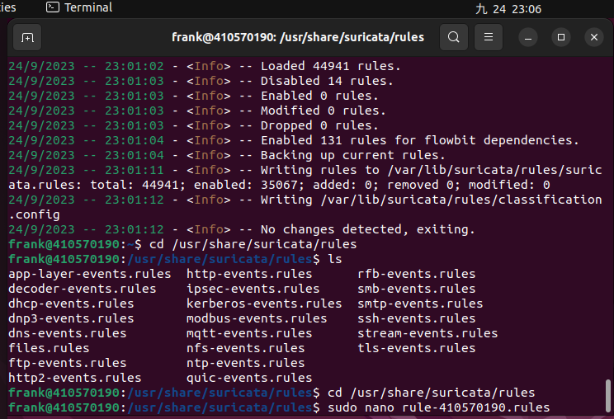
$ sudo nano rule-學 號.rules

Slide 19
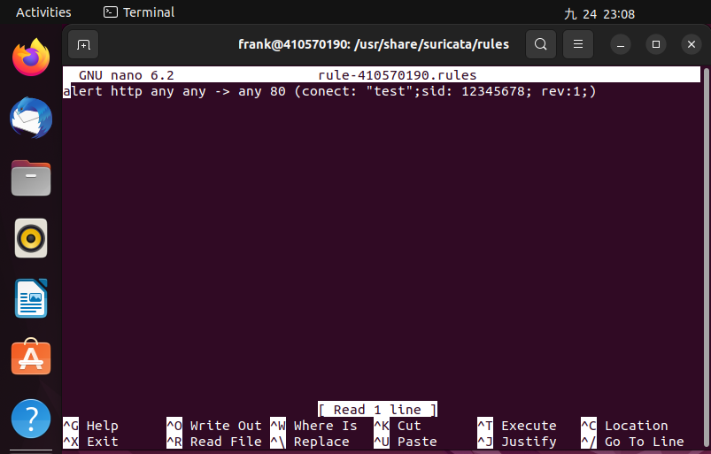
alert http any any -> any 80 (content: "test"; sid: 12345678; rev:1;)

Slide 20
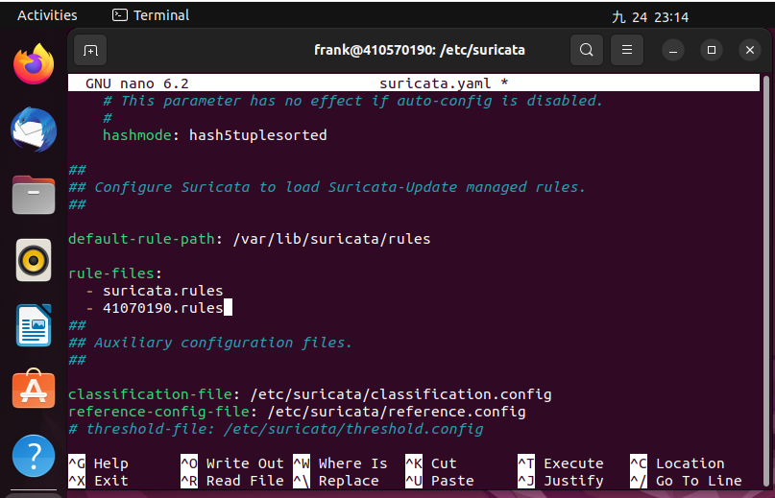
新增自訂規則檔到設 定檔
# 找到 rule-files:
# 並在下方 - suricata.rules 加入自 訂的規則檔路徑
#ex. - /etc/suricata/rules/r ule-學號.rules

Slide 21
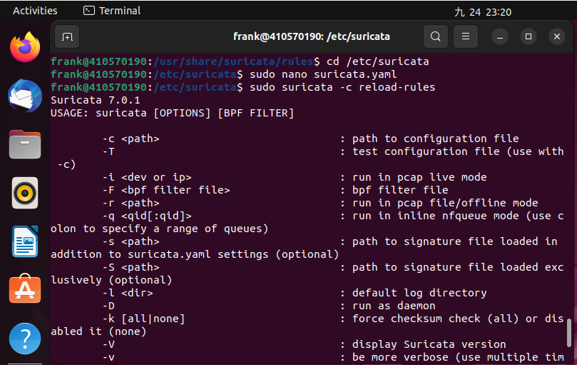
$ sudo suricatasc -c reload-rules

Slide 22
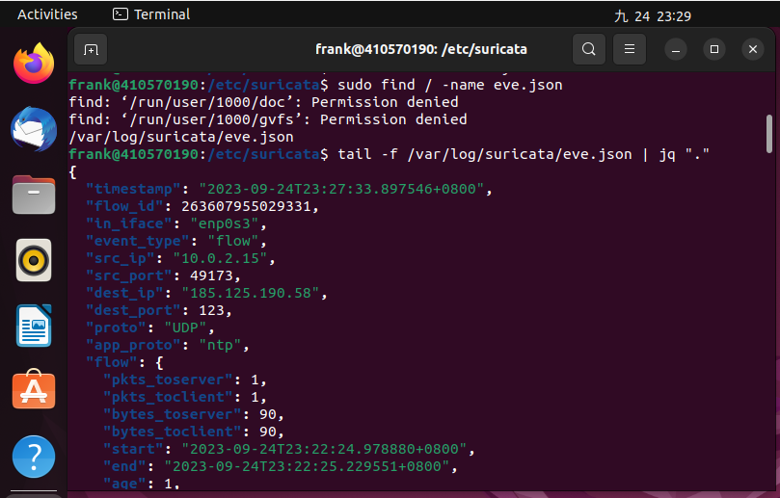
$ tail -f /var/log/suricata/eve.json | jq "."

Slide 23
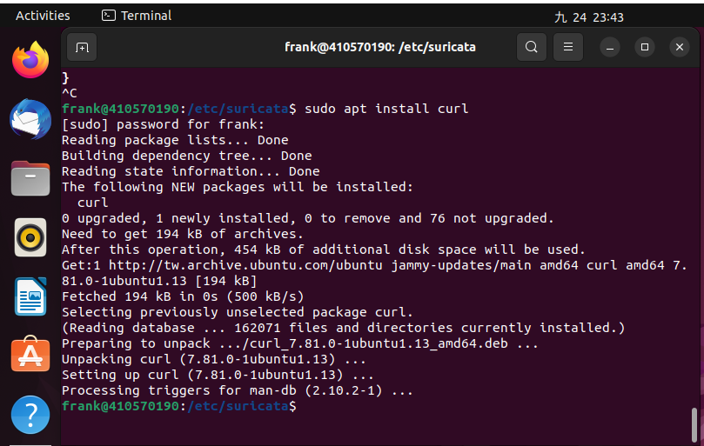
$sudo apt install curl

Slide 24
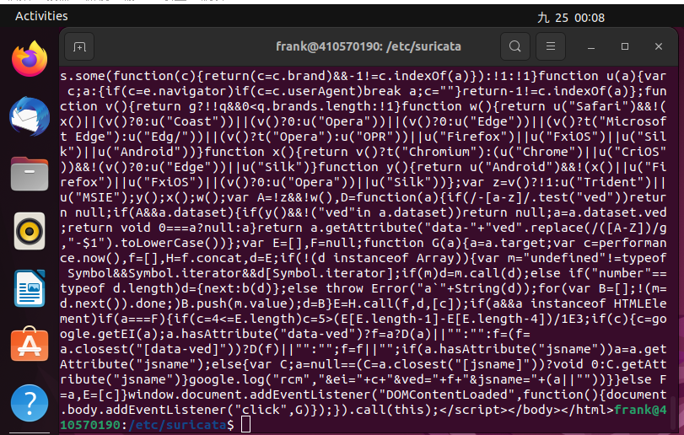
curl http://www.google.com.tw:80/

Slide 25
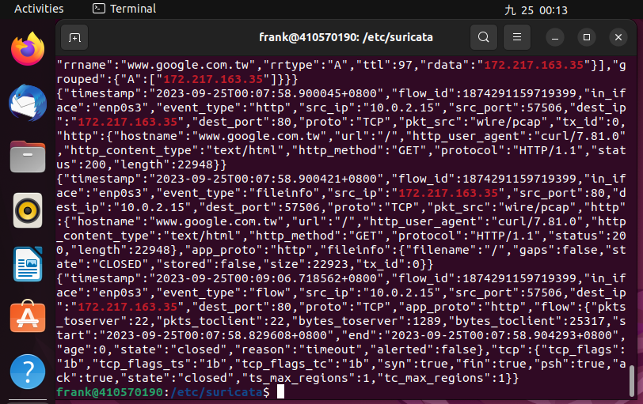
sudo cat /var/log/suricata/eve.json | grep “google”
Cat跟/var中間有空格、 json跟|有空格、|跟grep有空格

